Slide 1
MANLIFT PROCEDURES
OSBT SP-030-00
Employee education 2019

Slide 2
MANLIFT PROCEDURES
Purpose
Establishes the requirements for safely operating Manlifts at OSBT (and customer sites)
Provide training on OSHA’s standards regarding aerial lift devices.
Many factors affect the safety of operation including proper design, installation, and maintenance of the equipment.
It must be emphasized, however, that the most significant factor for safe operation is the ability of the individual employee to properly comply with the established operating procedures for Manlift use.
RE: OSHA standard 1910.68, Manlifts

Slide 3
MANLIFT PROCEDURES
Ariel Lift vs. Scissor Lift
Aerial device - Any vehicle-mounted device, telescoping or articulating, or both, which is used to position personnel.
Aerial (Boom) lift - Any aerial device used to elevate personnel to job sites above ground including extensible boom platforms, aerial ladders, articulating boom platforms and vertical towers.
OSHA covers the use of aerial lifts in CFR 1926.453 and 1926.454
Scissor lift - A mobile supported scaffold which can be powered or unpowered, is portable and caster or wheel-mounted.
OSHA classifies scissor lifts as mobile scaffolds and covers them under CFR 1926.451, 1926.452(w) and 1926.454.
The use of fall protection is required when using both lift devices!

Slide 4
MANLIFT PROCEDURES
Scissor Lifts
Boom Lifts
The electric- or gas-powered platform that is mounted on folding arms is used to provide elevated work areas or to help raise or lower unit loads.
The objective is to access difficult-to-reach areas in order to perform whatever work is required.
Scissor lifts provide a mobile means of reaching areas that are very high.
A maneuverable vertical boom with an open bucket or cage at the end from which a worker can perform aerial work

Slide 5
MANLIFT PROCEDURES
Scissor Lift
Best For:
Indoor use
Small spaces*
Multiple personnel
Narrow areas like warehouses
Height: 10 feet to 60 feet
Workspace size: 2 feet to 10 feet wide
Scissor lifts are used to elevate workers to high areas, and they are most used in manufacturing and industrial settings.
These lifts are supported by crisscrossing braces that extend upward.
Most scissor lifts are designed to move only up and down.
However, some can move a few feet horizontally.

Slide 6
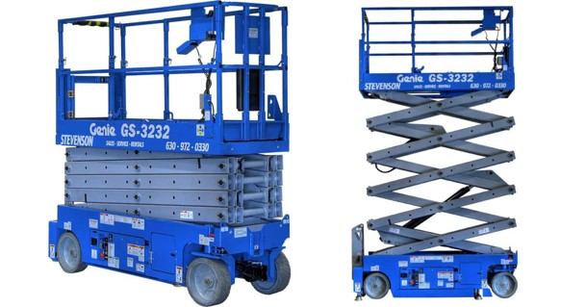
MANLIFT PROCEDURES
Scissor Lift

Slide 7
MANLIFT PROCEDURES
Ariel (Boom) Lift
There are two basic types of boom lifts:
Articulating boom lifts - Arms that bend, making it easier to move the bucket around things
Telescopic boom lifts – Straight arms, usually have higher weight capacities, but they are more difficult to maneuver
Boom lifts are a remarkably versatile type of aerial lift.
The major differences between types of boom lifts can be divided into three major categories:
Boom type
Bucket/workspace attachments
Power source

Slide 8
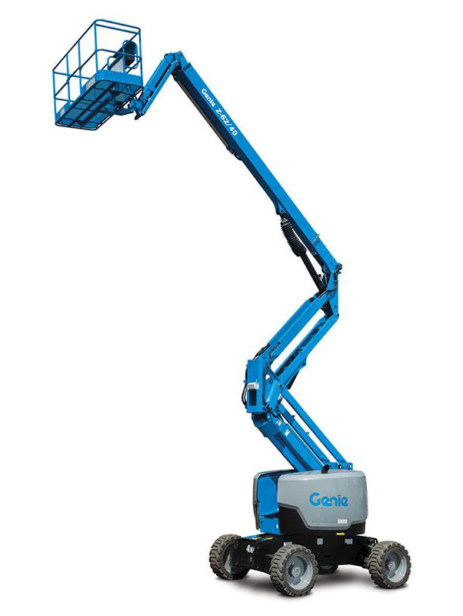
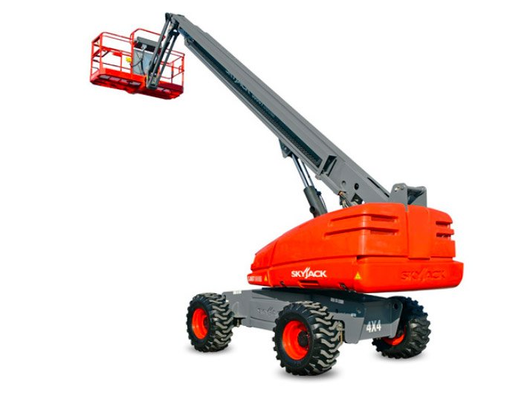
MANLIFT PROCEDURES
Ariel (Boom) Lift

Slide 9
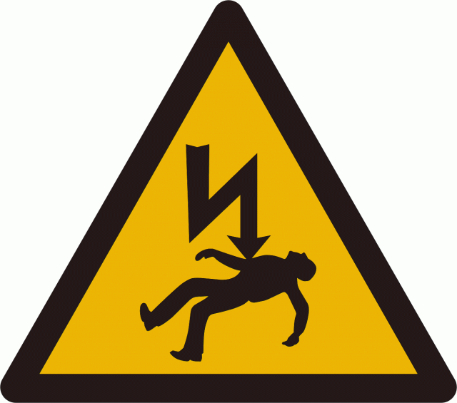
MANLIFT PROCEDURES
Hazards - Electrocution
One of the most common and deadly hazards associated with Manlift is electrocution from contact with electrical wires and conductors.
ANSI and OSHA standards specify minimum safe distances that are to be maintained while working in a Manlift.
If these distances cannot be achieved, do NOT use the equipment.
If using electrified tools while on a lift, use only tools that are double insulated or have a grounding plug.

Slide 10
MANLIFT PROCEDURES
Hazards – Electrocution (cont.)
If using an electromechanical model lift, ensure that the proper gauge of extension cord wire is used and that it is in good condition and equipped with a grounding plug.
Do not operate the machine outdoors if there is threat of lightening.
Do not operate during any type of inclement weather, including windy conditions, since fall and tip-over hazards are exaggerated in these conditions.
Personnel on the ground are prohibited from operating the ground controls when a Manlift is in contact with a live electrical source until such time as the electrical source is de-energized.
OSHA recommends that people working on or near live power lines should wear:
Insulated hard hats
Voltage-rated shoes
Rubber gloves and sleeves
Other protective clothing

Slide 11
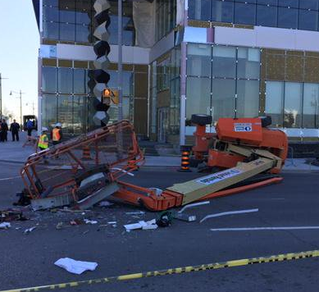
MANLIFT PROCEDURES
Hazards – Tip Over
Tip-overs are one of the leading causes for both boom and scissor lift accidents.
Scissor lift tip-overs are often due to operating in poor weather.
One of the main causes for aerial lift tip-overs is boom lift on uneven ground usage.
To avoid these manlift accidents,
workers should never:
Set up the aerial lift between overhead hazards
Exceed load capacity limits
Travel to a job site with an elevated lift
Use the lift on uneven terrain
Raise the platform in windy conditions

Slide 12
MANLIFT PROCEDURES
Hazards – Falls
Falls are most likely to occur when the worker, aerial lift, or scissor lift is hit by a crane, a vehicle or some other object.
Workers should ensure that fall protection measures are in place.
This includes making sure all cables and harnesses are attached to the lift before starting the job. When operating the lift, workers also need to ensure:
Access gates are closed
The body harness or restraining belt is attached to the boom or bucket with a lanyard
They are standing firmly on the floor of the bucket
They never lean on or climb over the guard rails
Falls from aerial and boom lifts are common due to the height in which operators work.
Scissor lift falls often happen when the lift is used on uneven ground or during rough weather.

Slide 13
MANLIFT PROCEDURES
Hazards – Caught in Between
Worker injury due to contact with objects outside the boom is a common event.
This type of manlift accident tends to occur when the bucket is being moved.
A worker gets caught between the edge of the bucket and another object, and injury occurs.
The object could be a roof joist, a beam, or something else that gets in the way.
Prevention tips:
Inspect the equipment to make sure there are no loose parts.
If there are rotating or moving parts, make sure they are properly guarded.
Avoid wearing loose clothing.
Workers on the ground should remain at a safe distance from the load.
Staying out of the loading area can prevent being involved in boom lift accidents.
Scissor lift operators can avoid “caught in between” accidents by staying clear of overhead hazards.
These hazards can include power lines, pipes and ceilings.

Slide 14
MANLIFT PROCEDURES
Hazards – Struck By
Collapsing materials injure and kill workers every year.
This type of accident occurs when workers aren’t aware of their surroundings and contact objects that come loose.
All workers should be informed of any unfinished building materials on a job site.
Workers should take care to prevent materials from coming loose and hitting people on the platform or on the ground.
Large or heavy falling materials can also cause scissor lift tip-overs.

Slide 15
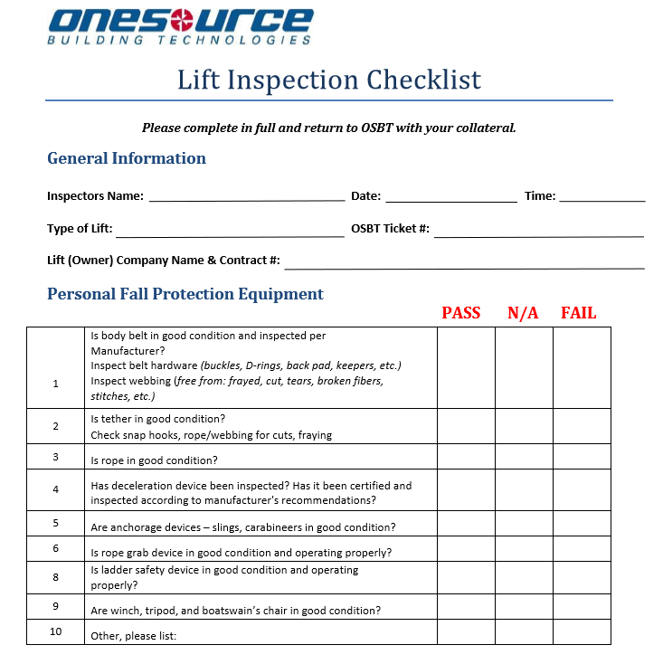
MANLIFT PROCEDURES
Pre-Use Instructions
OSBT and most manufacturers provide a list of items that should be inspected before each manlift use
A Lift Inspection Checklist and Lift Analysis Form (LSA) is required for all work orders where a list will be used.
Completed forms should be returned as part of required collateral.

Slide 16
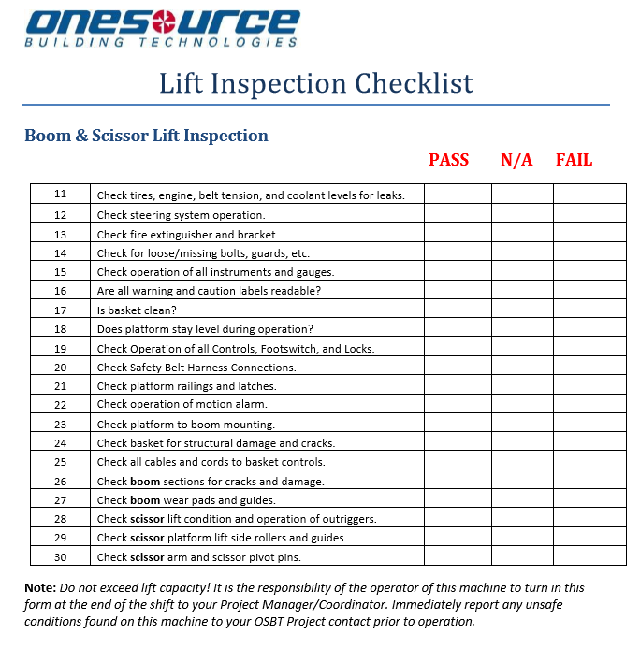
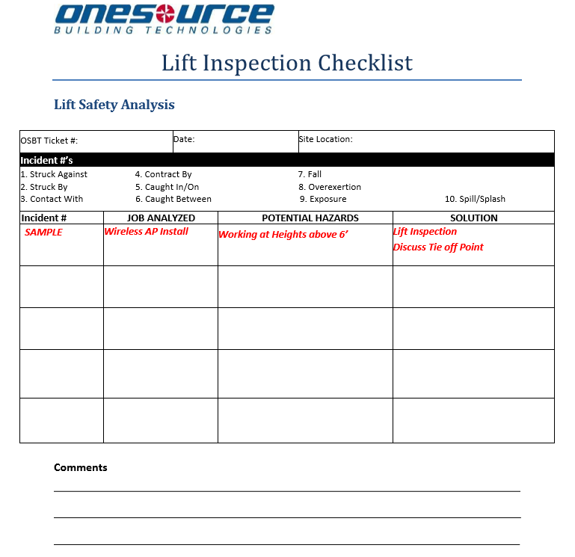
MANLIFT PROCEDURES

Slide 17
MANLIFT PROCEDURES
Work Site Inspection
It is necessary to inspect the work site also, items to inspect include:
The surface on which the lift will be used
Hazards that might create dangerous driving conditions
Weather conditions

Slide 18
MANLIFT PROCEDURES
General Safety Procedures
Most lifts are equipped with various safety features.
Never remove or use these features for any reason other than specified by the manufacturer.
Lifts should never be modified without written permission from the manufacturer or other equivalent entity.
If modified, the lift must be at least as safe as before it was modified.
Only authorized persons should operate an aerial lift.
Belting off to an adjacent pole, structure or equipment while working from a lift is not permitted.
Always stand firmly on the floor of the lift.
Do not sit or climb on the basket or guardrails or use planks, ladders or other items to attain a higher work position.

Slide 19
MANLIFT PROCEDURES
General Safety Procedures
The operator should know the total load of the lift including tools, supplies and other employees.
The weight of the load should be within the manufacturer's suggested maximum safe working load.
Make sure the load is balanced.
Lifts should never be used as a crane unless the manufacture has designed it to lift loads in such a manner.
Hard hats should always be worn by operators.
Before moving the lift, all (site) workers should be made aware of the move.
The operator should always refer to the lift's operator manual for any other safety procedures specific to the lift.

Slide 20
MANLIFT PROCEDURES
General Safety Procedures – Aerial Lifts
Brakes must be set and if the lift has outriggers they must be positioned on pads or a solid surface.
Wheel chocks must be installed before using an aerial lift on an incline, provided they can be installed safely.
An aerial truck should not be moved when the boom is elevated in a working position with men in the basket unless the lift is specifically designed for such operation.
Aerial work platforms must have both platform and lower controls.
Platform controls must be in or beside the platform within easy reach of the operator.
Lower controls should be able to override the platform controls but should not be used unless permission has been obtained from the workers in the lift or in case of emergency.
Before moving an aerial lift for travel, the boom(s) must be properly cradled and outriggers must be in stowed position.

Slide 21
MANLIFT PROCEDURES
General Safety Procedures – Aerial Lifts
Brakes must be set and if the lift has outriggers they must be positioned on pads or a solid surface.
Wheel chocks must be installed before using an aerial lift on an incline, provided they can be installed safely.
An aerial truck should not be moved when the boom is elevated in a working position with men in the basket unless the lift is specifically designed for such operation.
Aerial work platforms must have both platform and lower controls.
Platform controls must be in or beside the platform within easy reach of the operator.
Lower controls should be able to override the platform controls but should not be used unless permission has been obtained from the workers in the lift or in case of emergency.
Before moving an aerial lift for travel, the boom(s) must be properly cradled and outriggers must be in stowed position.

Slide 22
MANLIFT PROCEDURES
General Safety Procedures – Aerial Lifts
If transferring from the lift platform to an adjacent structure is necessary, 100% tie off is required.
To perform the transfer, two lanyards are required.
One must be anchored to the platform and the other to the structure.
The platform must be within one foot of the structure.
A spotter on the ground should guide the operator when transporting the lift from one area to another on the work site.
The operator must make sure that the boom is never over those working on the ground.

Slide 23
MANLIFT PROCEDURES
General Safety Procedures – Scissor Lifts
Never raise the platform while the lift is on a truck or other vehicle.
Employees/contractors should never ride on a scissor lift unless the following conditions exist:
The surface on which the lift is being moved is within 3 degrees of level and free of pits, holes and obstructions
The height to base width ratio of the lift during movement is two to one or less unless the lift is designed and manufactured to meet or exceed recognized stability test requirements such as ANSI/SIA A92.5 and A92.6
The lift does not travel more than 1 foot per second
No employee is on any part of the lift which extends outward beyond the wheels.

Slide 24
MANLIFT PROCEDURES
General Safety Procedures – Shutdown Procedures
Certain steps must be taken to ensure the safety of all employees and the lift in use.
Lift should be lowered ad safely resting on its supports
Secure lift to its supports to ensure that it does not move while being transported
Raise the outriggers
Shut off the power supply to the lift and outriggers
Remove pads used for outriggers and wheel chocks
Remove key from the ignition to prevent any unauthorized use of the lift
Check the operators manual for any additional procedures

Slide 25
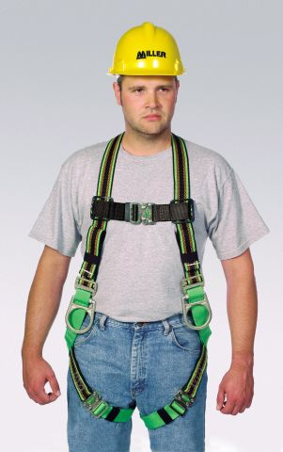
MANLIFT PROCEDURES
General Safety Procedures – Fall Protection
Fall protection is required for all employees that perform work on a lift if they are going to be elevated to a height of 10 feet above a lower level.
All scissor lifts require fall protection and guardrails that are properly designed, maintained and meet OSHA requirements meet that requirement.
If the guardrail does not meet OSHA standards, or if an employee leaves the safety of the work platform, then a personal fall arrest system utilizing a body harness is required.

Slide 26
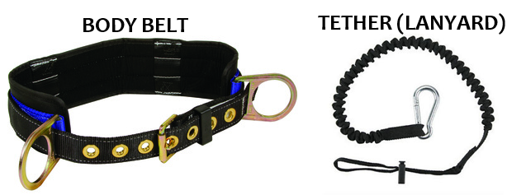
MANLIFT PROCEDURES
General Safety Procedures – Fall Protection
Currently there are 3 types of Fall Protection measures recognized by OSHA
For the purposes of OBST partners using lifts, we practice FALL RESTRAINT
Using a physical apparatus, restraint or tether to prevent a fall
Fall restraint systems require use of a body belt with a tether anchored to the boom or basket.
Fall restraint does not allow any fall distance.

Slide 27
Thank You!
Thank you for completing Manlift Procedures!
Complete the Manlift Procedures to receive credit for this module.
Have questions?
Contact HSSE@osbt.com

